Slide 1
Department of Applied Mathematics and Computational Sciences
III Sem M.Sc.Software Systems
Transform Techniques
Dr. V. Suresh kumar

Slide 2
Laplace Transform

Slide 3
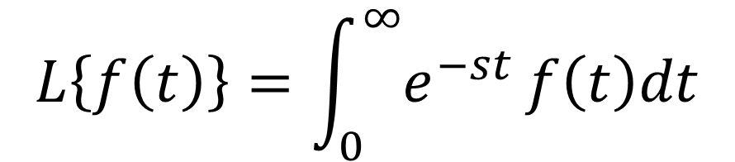
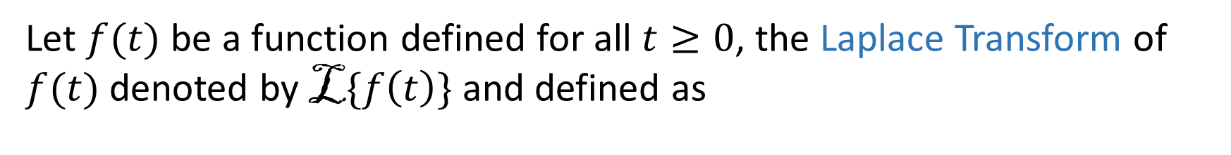

Definition
Let $f(t)$ be a function defined for all $t≥0$, the Laplace Transform of $f(t)$denoted by L$\{f\left(t\right)\}$and defined as
$$L\left\{f\left(t\right)\right\}=\int_{0}^{∞}{e^{−st}}f\left(t\right)dt$$
$$L\{f\left(t\right)\}=F(s)$$

Slide 4

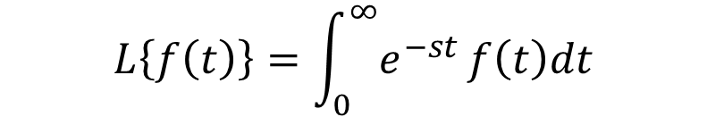
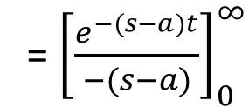


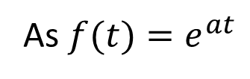

Example
Find the Laplace Transform of $f(t)=e^{at}$
Solution
$$L\left\{f\left(t\right)\right\}=\int_{0}^{∞}{e^{−st}}f\left(t\right)dt$$
We have
As $f(t)=e^{at}$
= ${\left[\frac{e^{−(s−a)t}}{−(s−a)}\right]}_{0}^{∞}$
$$L\left\{e^{at}\right\}=\int_{0}^{∞}{e^{−st}}e^{at}dt$$
$$L\left\{e^{at}\right\}= \frac{1}{(s−a)}$$
$$=\int_{0}^{∞}{e^{−(s−a)t}}dt$$
$$s−a>0$$

Slide 5
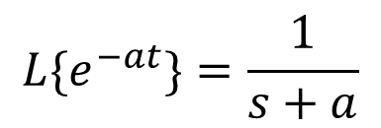
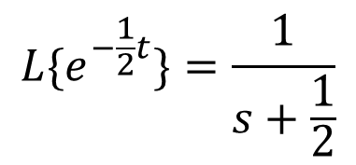
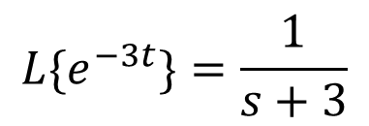
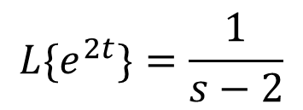
Note
It is easy to obtain that the Laplace Transform of $e^{−at}$
$${L\{e}^{−at}\}=\frac{1}{s+a}$$
By the same time
$${L\{e}^{2t}\}=\frac{1}{s−2}$$
$${L\{e}^{−3t}\}=\frac{1}{s+3}$$
$${L\{e}^{−\frac{1}{2}t}\}=\frac{1}{s+\frac{1}{2}}$$
. . .

Slide 6

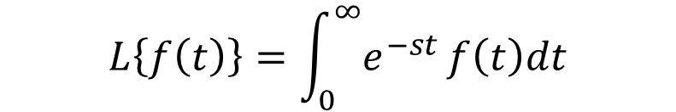

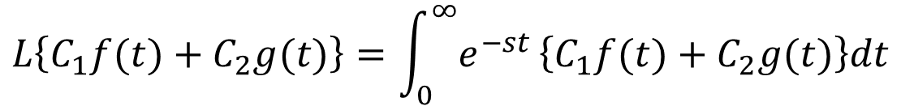
Linear Property
Statement:
Laplace Transform sum of two functions equal the sum of their Laplace Transforms and Laplace Transform of scalar multiple of a function equal to the scalar multiple of Transform of the function.
If $L\{f(t)\}=F(s)$and $L\{g(t)\}= G(s)$ then $L\{C_{1}f(t)+C_{2}g(t)\}=C_{1}F(s)+C_{2}G(s)$
Proof:
$$L\left\{f\left(t\right)\right\}=\int_{0}^{∞}{e^{−st}}f\left(t\right)dt$$
We have
LHS:
$$L\left\{C_{1}f(t)+C_{2}g(t)\right\}=\int_{0}^{∞}{e^{−st}}\left\{C_{1}f(t)+C_{2}g(t)\right\}dt$$
$=\int_{0}^{∞}{e^{−st}}\left\{C_{1}f(t)\}dt+\int_{0}^{∞}{e^{−st}}{\{C}_{2}g(t)\right\}dt$
$=C_{1}\int_{0}^{∞}{e^{−st}}f(t)dt+C_{2}\int_{0}^{∞}{e^{−st}}g(t)dt$
$=C_{1}L\{f\left(t\right)\}+C_{2}L\{g\left(t\right)\}$
$=C_{1}F(s)+C_{2}G(s)$
=RHS

Slide 7


